Slide 1
Introduction to Python
A Beginner's Guide

Slide 2
What is Python?
A high-level, interpreted programming language.
Created by: Guido van Rossum in the late 1980s.
Why Python?
Readable and Simple
Versatile - Used in web development, data analysis, artificial intelligence, scientific computing, and more.
Large Community
Key Features:
Interpreted Language.
Dynamically Typed.
Object-Oriented
Extensive Libraries.
Open Source & Free Software.

Slide 3
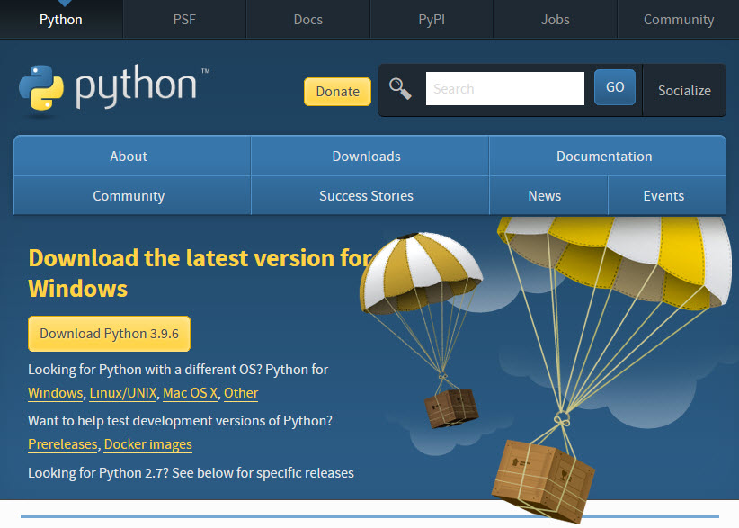
Python Installation:
Python Downloads: https://www.python.org/downloads/

Slide 4
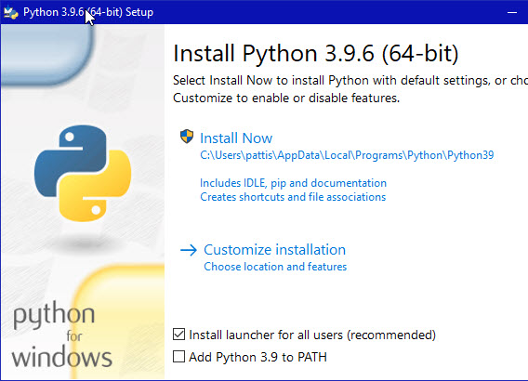
Python Installation:
Double-click the icon labeling the file python-3.9.6-amd64.exe. Double-click the icon labeling the file python-3.9.6-amd64.exe.
Ensure that both the Install launcher for all users (recommended) and the Add Python 3.9 to PATH checkboxes at the bottom are checked

Slide 5
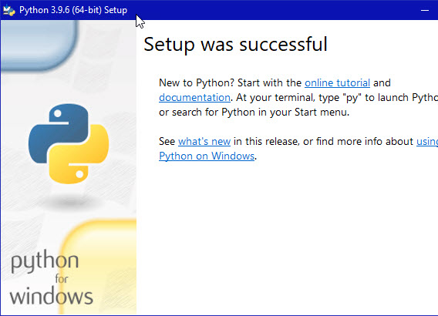
Python Installation:
During installation, it will show the various components it is installing and move the progress bar towards completion.
Click the Close button.

Slide 6
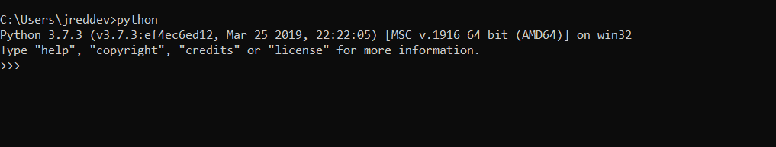
Python Installation:
Open Command Prompt & Type Python or python --v

Slide 7
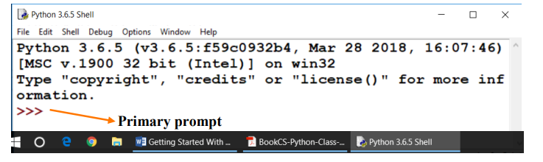
WORKING IN INTERACTIVE MODE
When we start python IDLE (Integrated Development and Learning Environment), we observe following window.
>>> is a primary prompt indicating that the interpreter is ready to take a python
command.

